Slide 1
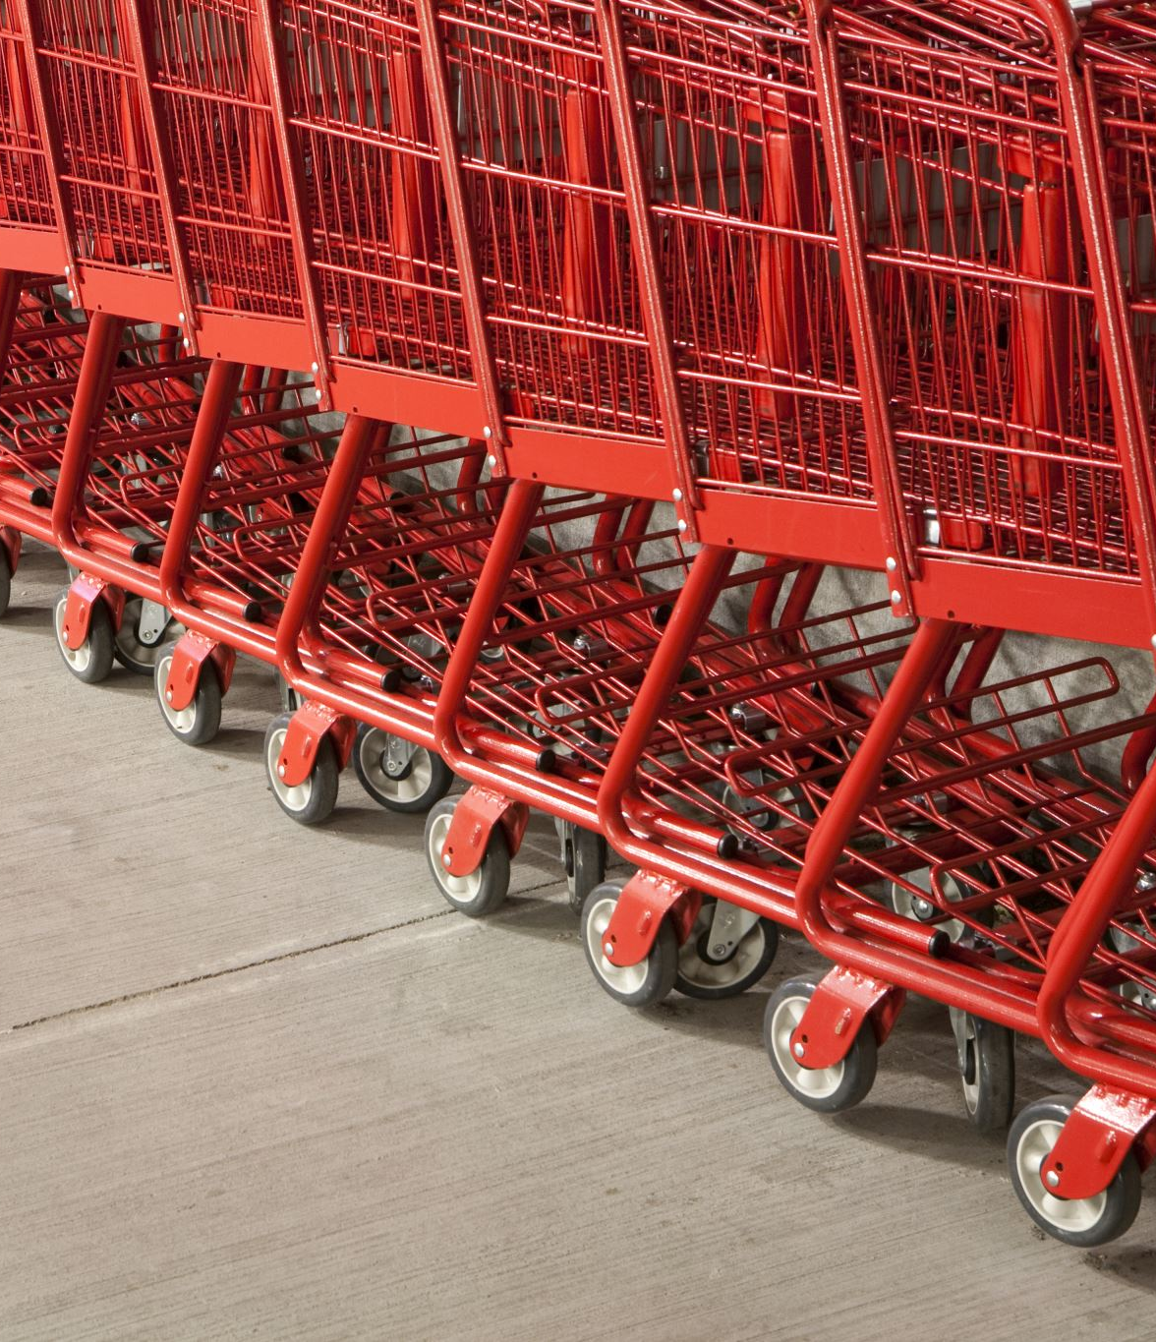
Big mart sales
10/6/2022
Ziad Ashraf

Slide 2
Objective
Introduction
About data
Problems
Solutions
Conclusions

Slide 3
Introduction
This project is about big mart sales analysis to get some insights about products, stores, and category sales in each region.

Slide 4
About data
The data were collected in 2013 for 1559 products from 10 stores in different cities. Also, specific attributes of each product and store have been defined.
The data have 12 variables and 8523 rows.
https://www.kaggle.com/datasets/mrmorj/big-mart-sales

Slide 5
Problems
What are the annual sales per category?
What are the factors that affect these sales?
The annual number of outlets established.
The correlation between sales and product prices.
The average product prices of each category per location.
The total product sales of each category per location.

Slide 6
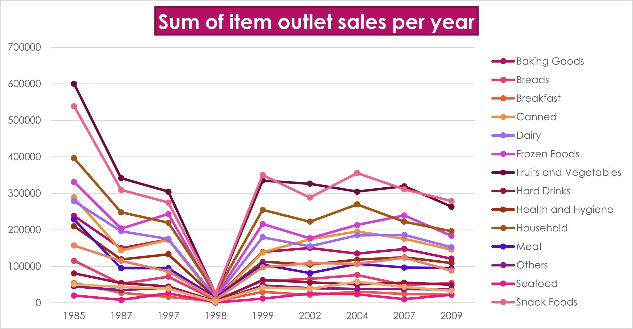
What are the annual sales per category?
This chart shows that all categories' total sales fell in 1998.
The fruits and vegetables are the most sold since 1985.

Slide 7
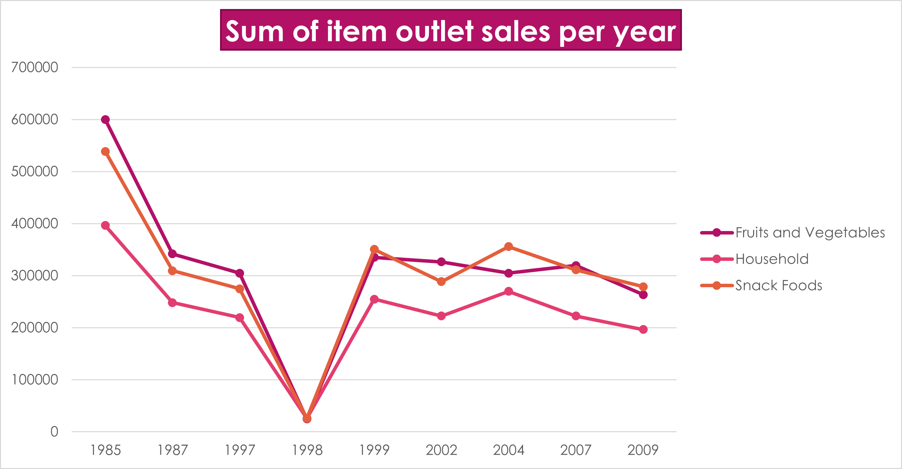
Top 3 annual sales categories.
The fruits and vegetables are the most sold since 1985.
The snack foods are the second and the household category is the third.

Slide 8
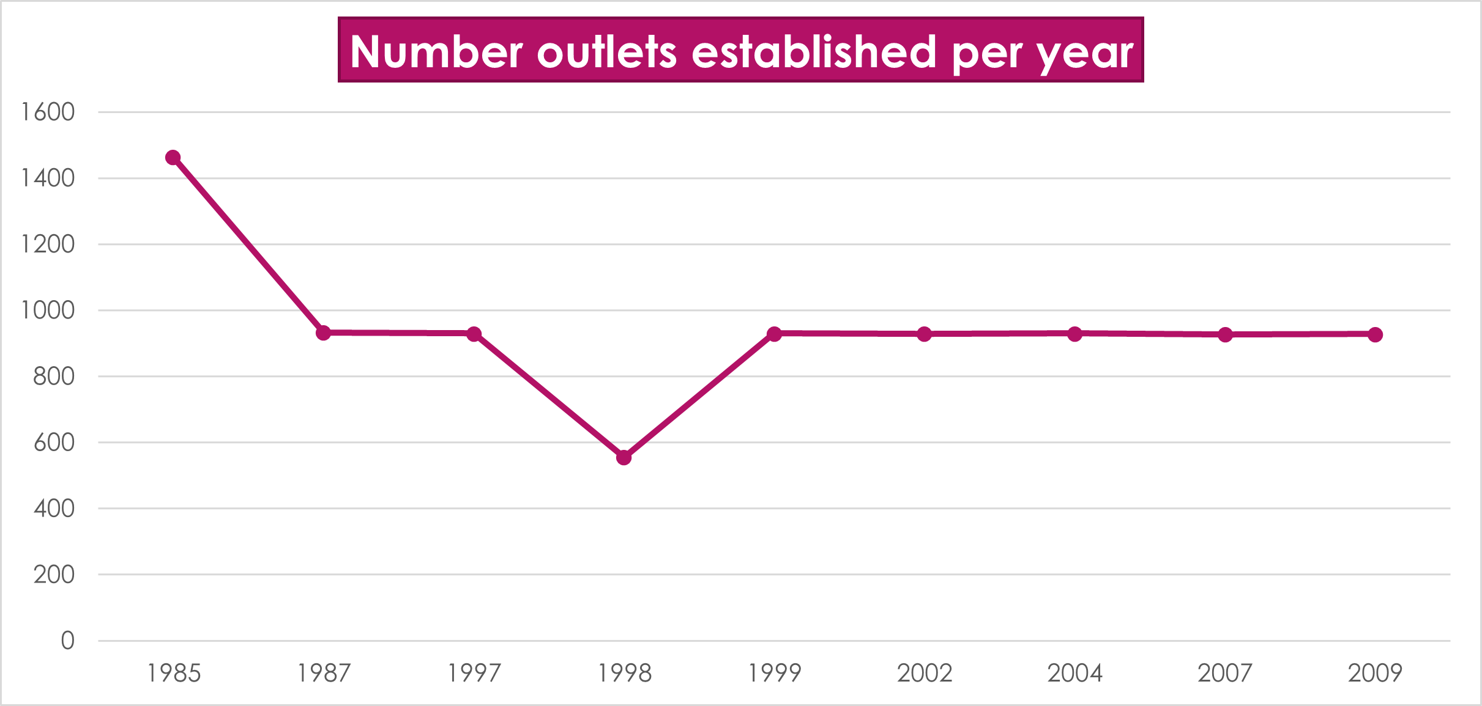
The annual number of outlets established.
The annual number of outlets established in 1998 is smaller than in other years so the total sales for 1998 are the lowest.

Slide 9
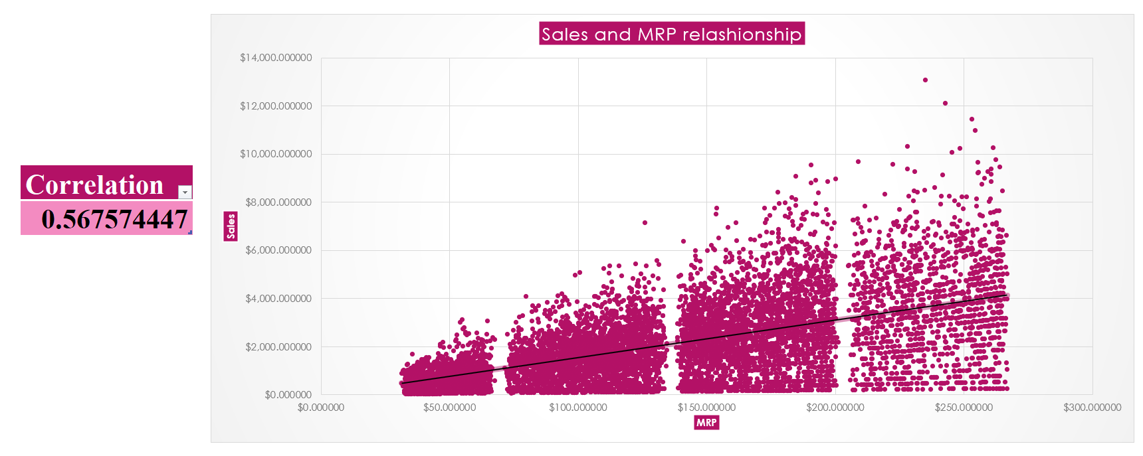
The correlation between sales and product prices.
This plot shows a positive correlation between product price and sales. So, when the price increases the sales increase.
The correlation measure is 0.567 indicating a positive correlation between them.

Slide 10
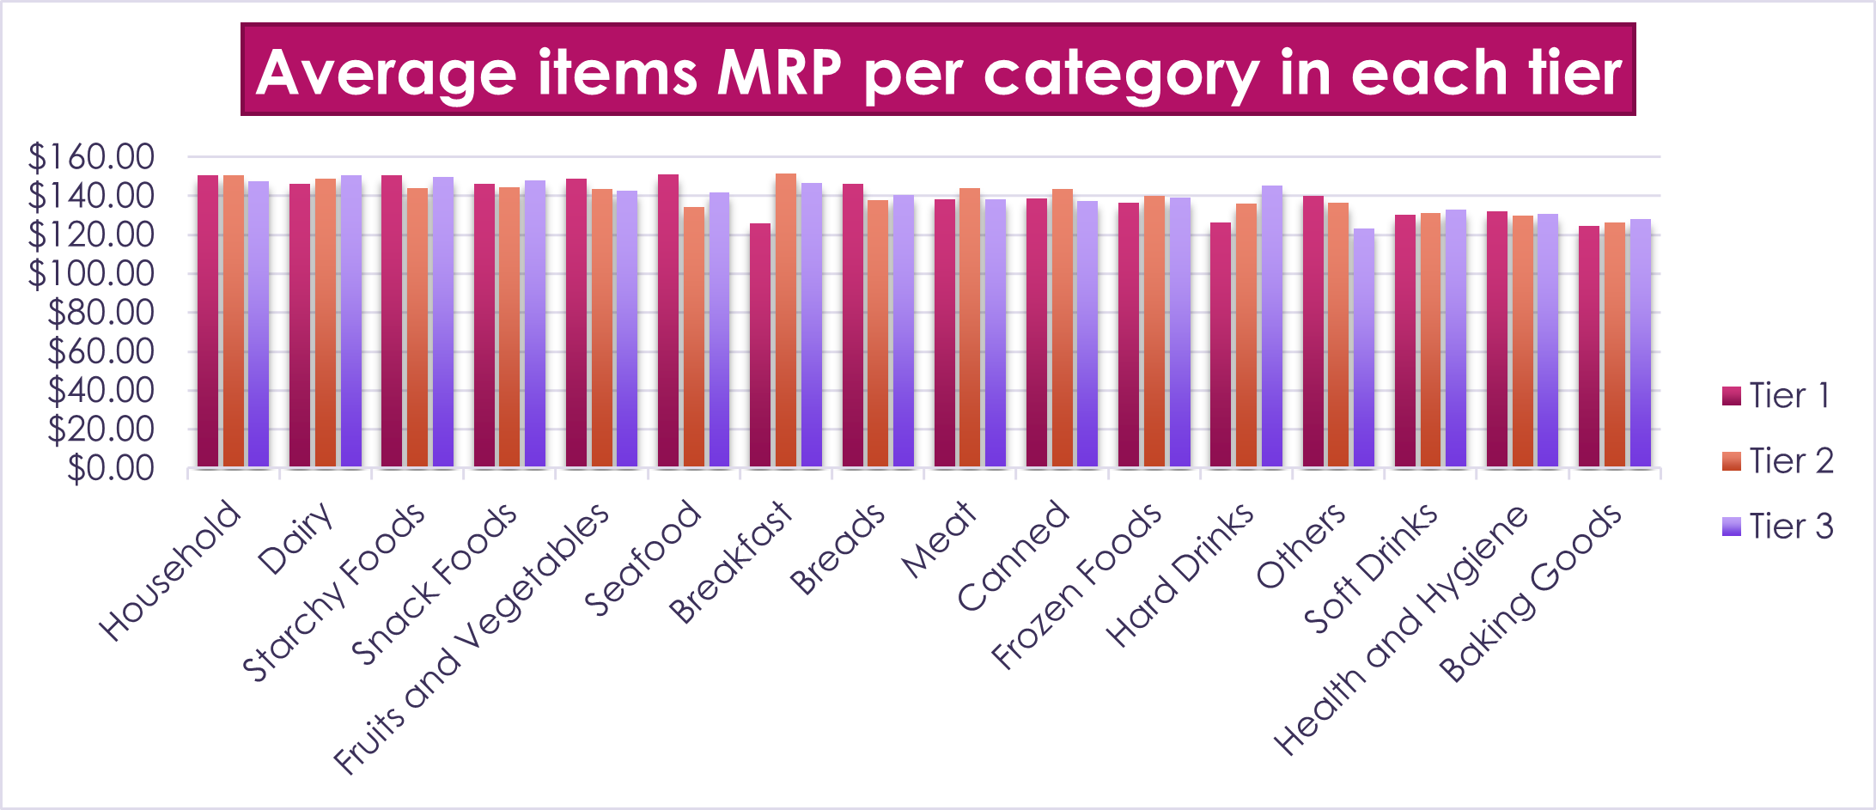
The average product prices of each category per location.
The average prices of the household category are the largest in all tiers, but the baking goods are the lowest.
The difference in average prices between each tier is very small so the average prices per location don't affect sales growth.

Slide 11
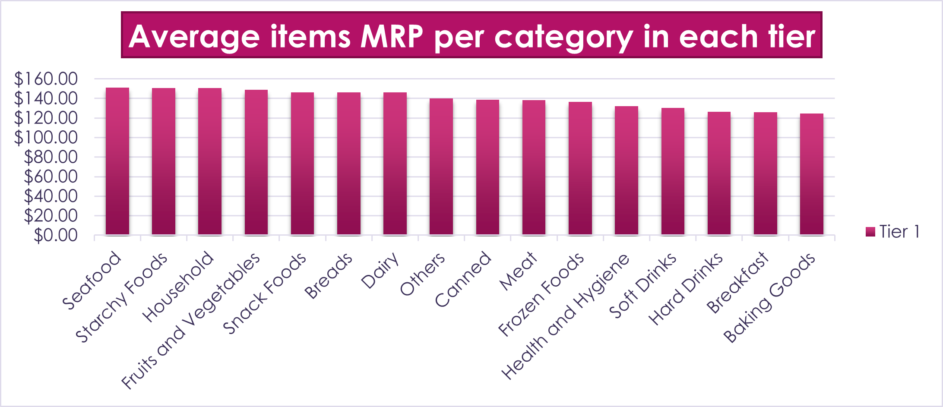
The average product prices of each category in tier 1.
The average prices of seafood and starchy foods are the largest in tier 1, but the baking goods are the lowest.

Slide 12
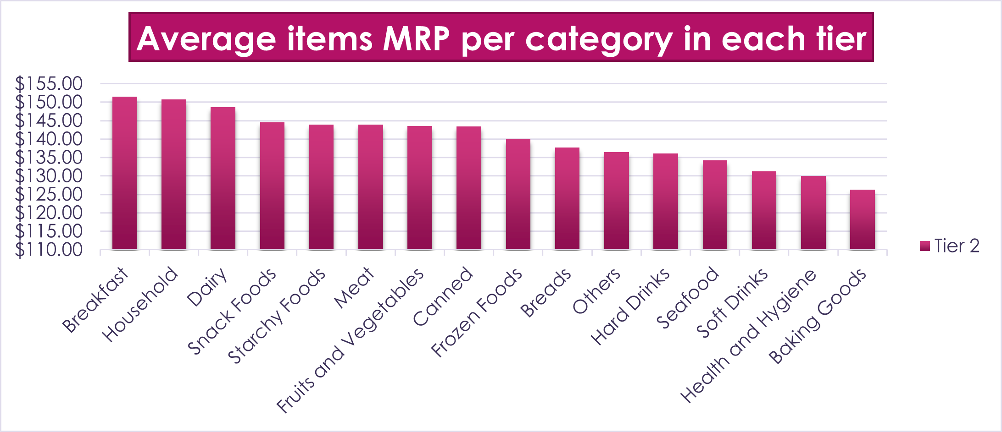
The average product prices of each category in tier 2.
The average prices of breakfast and household are the largest in tier 2, but the baking goods are the lowest.

Slide 13
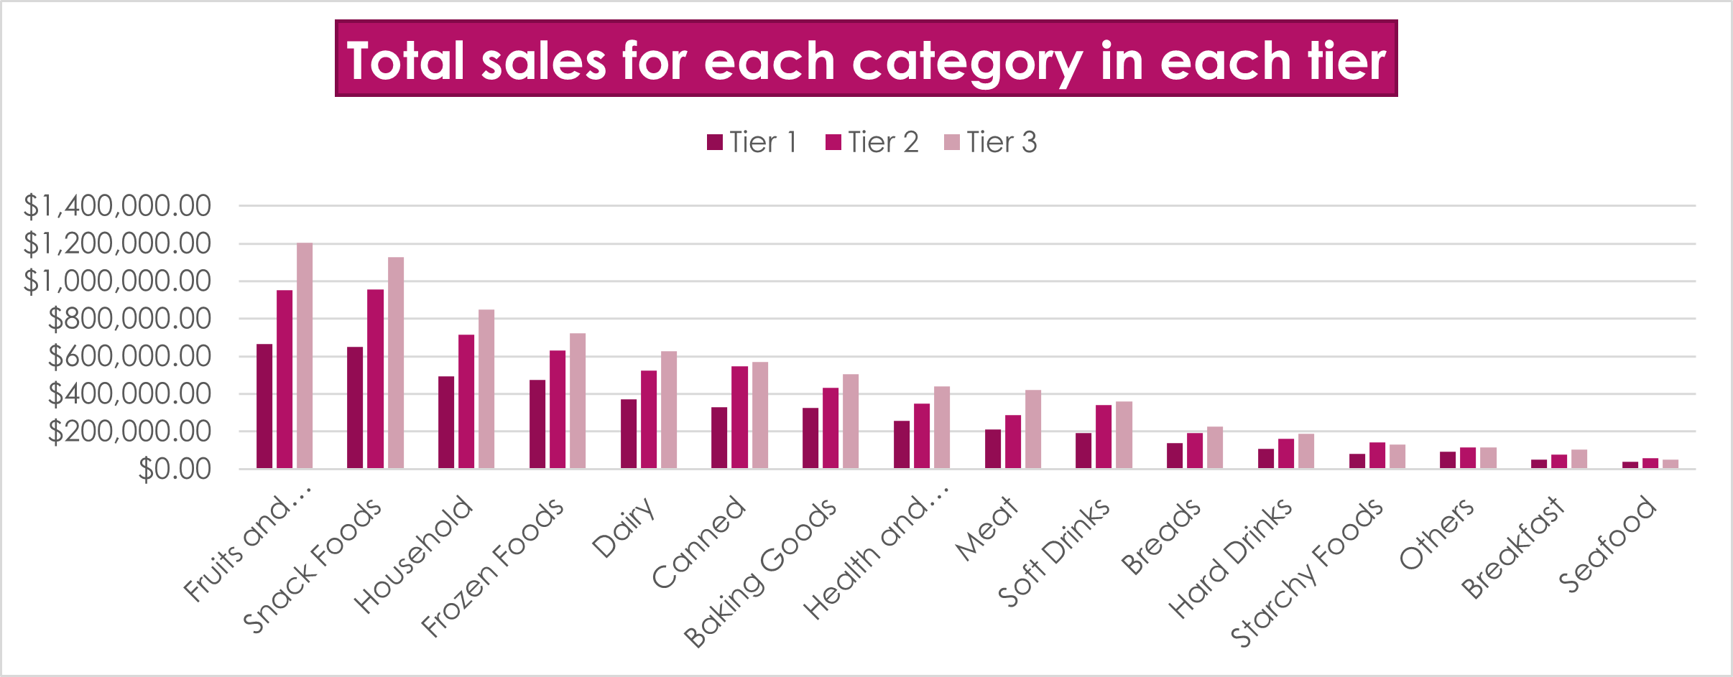
The total product sales of each category per location.
The total sales in tier 3 are the largest in each category.
The fruits and vegetable category has the largest total sales in all locations.
The seafood has the lowest total sales in all locations.

Slide 14
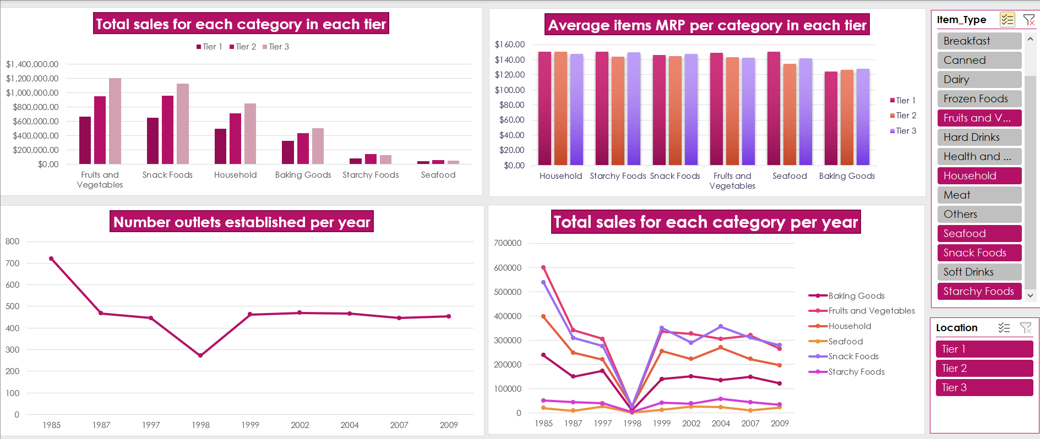
Dashboard
This dashboard is for the most important categories that we mentioned in the last pages.

Slide 15
Conclusions
The outlets that will be established should be in tier 3 because the most considerable sales are there.
They should focus on vegetables, fruit products, snack food, and household products in their new outlet.
They should focus on baking goods because their prices are low.
They should avoid seafood and starchy food in tier 3.
They should increase the prices to increase their sales.

